Slide 1
The Town of Manchester
Feasibility Study
Janell Johnson, Chief Growth Officer
Aaron Johnson, Senior Vice President
Bryan Feather, Executive Vice President

Slide 2
The Friends of Manchester Council on Aging’s Feasibility Study
The Town of Manchester engaged Kinetic, a leading global fundraising consulting company with headquarters in Kansas City, to conduct a Feasibility Study to refine, present and test the potential for a $3-million campaign: Anchored in Community. The campaign’s initiatives are to build a new Senior Center dedicated to supporting the seniors as valued members of the community while enhancing their well-being and quality of life.

Slide 3
Presented in Seven Sections
Kinetic’s Feasibility Study and Campaign Assessment Report
Your Power of Philanthropy
Campaign Assessment Findings
Campaign Readiness Review
Campaign Recommendations
Wealth Screening
Charitable Foundations Research and Qualification
Supporting Exhibits

Slide 4
Internal Assessment
Key Feasibility Assessment Activities
Campaign Readiness Review meetings were held virtually in February, March, April, May and June 2025
External Assessment
Conducted personal interviews and surveys in June 2025
Connected with 124 current and prospective donors.

Slide 5
Kinetic recommends a campaign goal of $3 million and a timeline of one year:
Campaign Recommendations
Recommendation based on the wealth screening of donor database; quality, input and insight from the interviews; outcomes of charitable foundation research; indications from those interviewed of a personal gift and/or gifts they could influence; and Kinetic experience and analysis.
A timeline of 12 months is recommended beginning in October 2025 and running through September 2026.

Slide 6
With Kinetic’s guidance, the Friends of Manchester COA will be positioned to build the core elements that drive a successful campaign through Anchored in Community:
Donor-Centered Approach
Celebration of Philanthropy
Compelling Case for Support
Engaged Volunteer Leadership
By embedding these elements into every aspect of the campaign, Anchored in Community will not only secure the resources needed for the new Senior Center but also strengthen the culture of philanthropy for the center for years ahead.

Slide 7
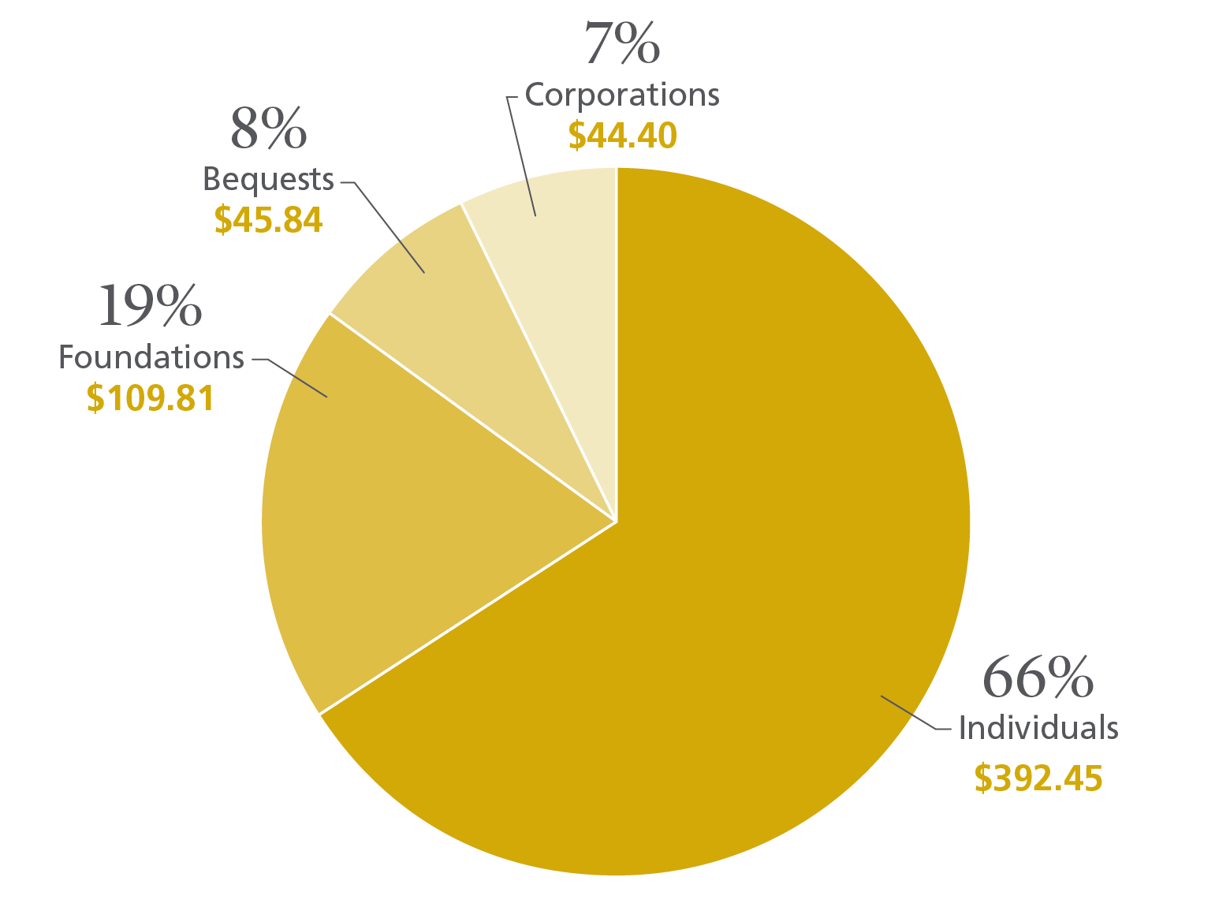
7
2024 contributions: $592.50 billion by source of contributions
(in billions of dollars – all figures are rounded)
Source: Giving USA

Slide 8
Attracting Financial Support
Expand visibility
Target your philanthropic audience
Grow volunteer leadership
Work the plan

Slide 9
Section 2: Campaign Assessment Findings
Shared with over 2,000 individuals
124 interview and survey responses
14 questions asked
Snapshot of constituents’ perceptions
Overview of questions and summary of responses

Slide 10
Key Campaign Assessment Outcomes
The Manchester-by-the-Sea Council on Aging is distinctive and important.
Strong support expressed for The Friends of Manchester Council on Aging’s proposed campaign and its mission.
If the mission is pursued, and the prospects are properly identified, qualified, cultivated, solicited and appreciated, The Friends of Manchester Council on Aging’s campaign can be successful.

Slide 11
Section 3: Campaign Readiness Review
1. Strategic Plan 9. Communications
2. Case Statement 10. Fundraising Staff
3. Donor Constituency 11. Leadership
4. Market Involvement 12. Involved Board
5. Efficient Record Keeping 13. Potential Large Gifts
6. Fundraising Plan 14. Fundraising Leadership
7. Prospect Development 15. Fundraising Research Application
8. Event Strategy

Slide 12
Key Feasibility Study Assessment Recommendations
Focus on building donor relationships.
Prioritize donor prospects.
Ensure organizational transparency and clear policies.
Develop a strategic public relations plan.
Strategically communicate with your philanthropic community.
Articulate board fundraising responsibilities.
Provide campaign and fundraising training.
Secure stretch gifts from campaign leaders.
Formalize your donor appreciation program.
Refine your fundraising events strategy.
Utilize prospect research.
Dedicate resources to campaign management.

Slide 13
Section 4: Key Campaign Recommendations
Set your campaign goal.
Set your campaign timeline.
Set your campaign pledge period.
Partner with Essex County Community Foundation.
Shared Vision, Stronger Impact: Unifying the Message for Community Support.
Use a Chart of Giving to guide your campaign.
Engage your campaign counsel.

Slide 14
Section 5: Wealth Screening
Provides valuable information about a prospect's potential capacity to support the Friends of Manchester COA with a major gift.
Kinetic reviewed over 4,000 profiles.
Results represent philanthropic potential and are considered in the basis of the campaign goal recommendation.
Findings provide a significant field of opportunity for major gift cultivation and solicitation as the campaign gets under way

Slide 15
Chart of Giving: $3 million comprehensive campaign
Gift Level | Number prospects needed | Gifts Needed | Total Level | Running Total | Running % of Total
$500,000 | 3 | 1 | $500,000 | $500,000 | 17%
$250,000 | 6 | 2 | $500,000 | $1,000,000 | 33%
$100,000 | 6 | 2 | $200,000 | $1,200,000 | 40%
$75,000 | 18 | 6 | $450,000 | $1,650,000 | 55%
$50,000 | 39 | 13 | $650,000 | $2,300,000 | 77%
$25,000 | 36 | 13 | $325,000 | $2,625,000 | 88%
$10,000 | 51 | 17 | $170,000 | $2,795,000 | 93%
$5,000 | 63 | 21 | $105,000 | $2,900,000 | 97%
$2,500 or less | 120 | many | $100,000 plus | $3,000,000 | 100% plus

Slide 16
Section 6: Charitable Foundation Research and Qualification
Using key words and funding areas that are relevant to Friends of Manchester COA’s campaign, Kinetic performed a comprehensive analysis utilizing the latest 990s filed with Candid’s Foundation Directory to determine foundations with overlapping giving interest.
Kinetic identified several foundations with giving history of more than $3.7 million with a local or regional focus.
The foundations identified indicate donor potential but are not guarantees.
As with individual donors, relationships with foundations must be cultivated before proposals are submitted to create the highest likelihood of positive results.

Slide 17
Section 6: Supporting Exhibits
Case statement
Sample fundraising policies
Timeline
Consultants’ biographies
Campaign assessment responses will be provided in a separate attachment

Slide 18
Next Steps
Discuss and accept recommendations.
Engage campaign counsel
Let's get started! Begin work in October 2025.

Slide 19
Questions
Comments
Discussion

Slide 20
Thank You

